Slide 1
KP1 A&B
Fuel line diesel filter to engine

Slide 2
General requirements
All parts should comply with PF.90197; functional requirements must demonstrate P99C90, and durability requirements must demonstrate P95C90;
All lines should be capped on all ends, shall be protected from contamination during shipping and handling (Cap.9.91220)
The 3D models in SP for all clips are designed based on current fuel and vapor line size, only for supplier reference. If supplier have the different size of Nylon line with 3D models in SP, supplier have the responsibilities to revise the design of clip in order to make sure the fuel bundle can comply with the following requirements (DV test is mandatory):

Slide 3
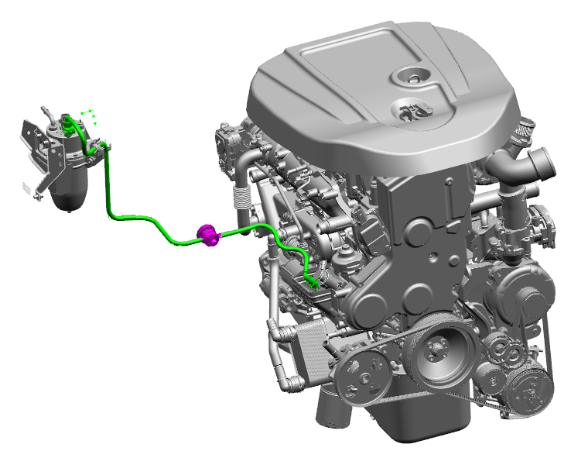
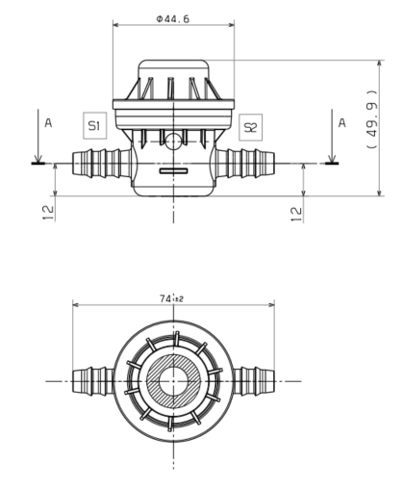
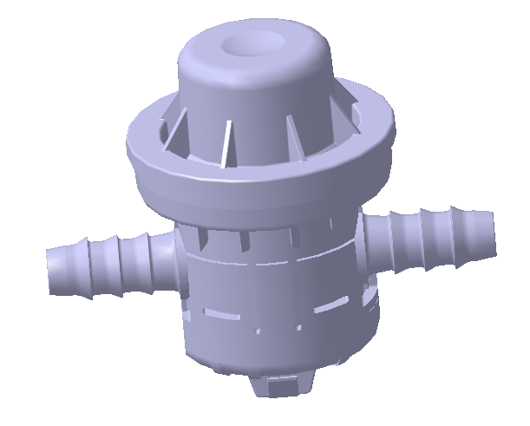
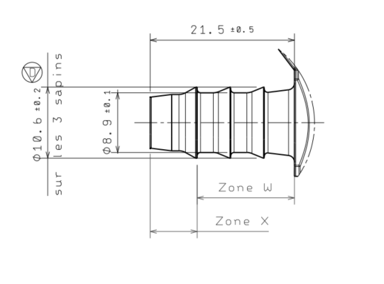
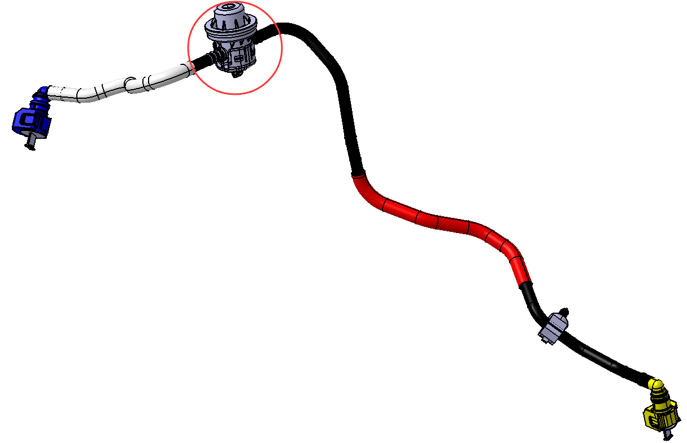
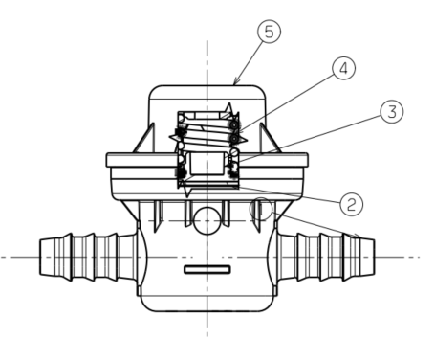
FC00SAA78530 Fuel line diesel filter to engine
Damper:
Supplier Nobel Auto.
Working Pressure:4.5bar
FUEL FILTER
SIDE

Slide 4
FC00SAA78530-Fuel SUPPLY LINE FILTER TO ENGINE
LEVEL |  |  | ITEM | FCA PART N° | SUPPLIER PART N° | QTY | MATERIAL | SPEC. | SUPPLIER | NOTE
0 |  |  | Fuel line damper |  |  | 1
 | 1 |  | Capot | - |  | 1 | PA66+PA6 | PF.90197
 | 1 |  | Spring compression 4.5bars | - |  | 1 | NF EN 10270-3 | PF.90197
 | 1 |  | plug | - |  | 1 | PA66 GF30 | PF.90197
 | 1 |  | membrane |  |  | 1 | 54U6002+AgN91S
 | 1 |  | Damper 8*10 | - |  | 1 | PA66 GF30 | PF.90197

Slide 5
Backup

